Slide 1
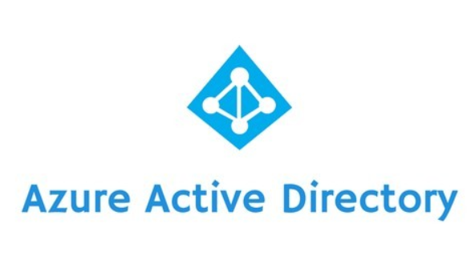
Module 4 Azure Active Directory
Section 6 - Application Permissions and Consent Model
June 2018

Slide 2
Agenda – Module 4 - Section 6 – Application Permissions and Consent Model
01
Azure AD Application Model & Terminology A quick introduction to the Azure AD Applications model
02
Permissions & Consent concepts Overview of the core concepts of the Azure Application permissions & consent model
03
Existing Consent Flow Illustration of the Azure Consent Flow
04
Supported Application Authentication Scenarios Explanation of each supported application authentication flow
05
Application Azure AD objects Review of the Azure AD objects related to Azure AD Applications
06
Best Practices Quick takeaways
Notes:
Goal of this chapter :
Understand the Azure AD Applications Permissions and Consent model

Slide 3
Azure AD Application Model
The application model in Azure AD is designed to sustain many different functions:
It holds all the data required to support authentication at run time.
It holds all the data for deciding what other resources an application might need to access and whether a given request should be fulfilled and under what circumstances.
It provides the infrastructure for implementing application provisioning, both within the app developer’s tenant and to any other Azure AD tenant.
It enables end users and administrators to dynamically grant or deny consent for the app to access resources on their behalf.
It enables administrators to be the ultimate arbiters of what apps are allowed to do and which users can use specific apps, and in general to be stewards of how the directory resources are accessed.

Slide 4
What is Application Consent?
We use permissions and consent every day – think of apps on your cell phone
The Azure AD Permissions and consent model is very similar
Organizational data is accessed through resource (APIs) that expose permissions
Applications need access to organizational data at different levels
Those permissions can granted through application consent by an admin, or end user
Those permissions can be managed over time by an end user, admin, or developer

Slide 5
Terminology
Client
The client application requesting access to data
Resource
The application/service (usually a web API - such GRAPH API) that exposes data
Permission
The ability for a client application to perform some action on some data owned by a resource application
e.g. read a user’s OneDrive files through Microsoft Graph
Consent prompt
The process by which a user is asked to grant an application the permission(s) it has requested
Consent grant
The result of saying “yes” to a consent prompt
Admin(istrative) Consent
The process by which a company administrator grants an application one or more permissions that cannot be granted by a regular user. These permissions may:
Allow the app to perform high privilege operations- admin-restricted permissions
Apply to all users in the organization

Slide 6
Core concepts : Azure AD Application Model - Registering an application
Any application that wants to use the capabilities of Azure AD must first be registered in an Azure AD tenant.
Allows Secure Sign in and Authorization
Azure AD only issue tokens to applications registered in the tenant
Application represented in Azure AD by 2 object classes:
Application object – Stores information about the application
Service Principal object(s) – Represents an “instance” of the application
How does an application get registered in a tenant? 2 cases :
Single tenant application
App for users in a single organization
Admin or user registers app in directory tenant
1 Application object + 1 Service Principal object in the same tenant
Multi-tenant application
App for users in multiple organizations
Admin or user registers app in developer’s directory tenant
Admin configures application to be multi-tenant
User prompted to consent based on permissions required by application
Consent registers application in user’s tenant
1 Application object in developer’s tenant + a Service Principal objects in each customer tenant
Tools for registering an application
Azure Management Portal / Visual Studio / Graph API
Notes:
Any application that wants to use the capabilities of Azure AD must first be registered in an Azure AD tenant.
This registration process involves giving Azure AD details about your application, such as the URL where it’s located, the URL to send replies after a user is authenticated, the URI that identifies the app, and so on.
App Registration
To integrate an application with Azure AD, the App has first to be registered in Azure AD
Allows Secure Sign in and Authorization
To register an application following information is needed:
Name
Application Type: Native (public oauth client), web applications (running on secure server = oauth confidential client)
Sign-On URL (Used by users to sign-in)
Redirect URL (For native applications, where Azure AD returns tokens responses
Multi-Tenant Application:
Application can be configured to accept sign-ins from any Azure AD tenant
Users will be able to access the application after giving consent
After consenting to the app, a service principal is generated in the users home tenant
Can be configured on app registration
Registering an application causes two objects to be created in Azure AD:
Application object (1 application : 1 application object in AAD)
Provides identity-related information for an application
Resides only in the Azure AD tenant where the application is registered (the “home” tenant)
Global representation of your application for use across all Azure AD tenants
Service Principal object (1 application : 1 or more service principal objects in AAD)
Provides local representation of an application within a specific Azure AD tenant
Defines policy and permissions for an application so the application can access resources at run-time
Each Azure AD tenant that an application needs to access must have a service principal object
a single tenant application will have one service principal
a multi-tenant application will have a service principal in each tenant where a user or administrator has consented to allow the application to access their Azure AD resources
See
http://www.cloudidentity.com/blog/2013/04/16/the-windows-azure-ad-application-model/
https://docs.microsoft.com/en-us/azure/active-directory/develop/active-directory-integrating-applications
https://docs.microsoft.com/en-us/azure/active-directory/develop/active-directory-application-objects
Doc on consent and permissions: https://docs.microsoft.com/en-us/azure/active-directory/active-directory-apps-permissions-consent

Slide 7
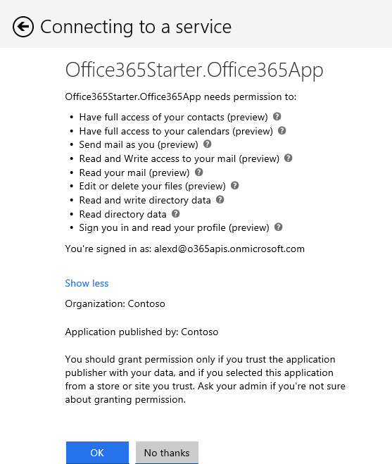
Core concepts : Azure AD Application Model - Consent Framework
Azure AD is heavily based on a consent framework
Consent is the act of granting an application access to certain resources by a user:
Cannot grant more than what a user has access to
Admin consent or user consent
Once an application is consented, a service principal is created in the tenant, information about the consent is stored (e.g., who consented to the app, what kind of consent, permissions granted)
Single AutheNtication (AuthN) and AuthoriZation (AuthZ) flow for apps
Azure AD Graph, Exchange, SharePoint
Device (native) apps and web apps
Admin or end-user consent
Use a Secure protocol
OAuth 2.0
No capturing user credentials
Fine-grained access scopes
Supports MFA and federated user sign-in
Long-term access through refresh tokens
Notes:
Azure AD is heavily based on a consent framework
The consent framework allows for applications to access resources within and outside the directory (tenant) they are registered in
Resources include Microsoft Graph, Office 365 API, or other Web APIs developed internally
The framework is based on users or administrator giving consent to other applications that need to be added to their directory and access directory data.
What is consent?
Consent is the process of acquiring an application to be used in a tenant. During acquisition, you can specify the permissions that are granted to the application in that tenant. Consent can be on behalf of all users in a tenant, or for individual users. Inside the directory, permissions are recorded as delegation entries, exposed in graph api as OAuth2PermissionGrants. Each user can have a different set of permissions, however, this is not easy for the client applications to handle.
Applications can also access apis with no user context (Application only flow), where the permissions are recorded differently. The permissions are recorded differently in these cases – entitlement grants or role memberships.

Slide 8
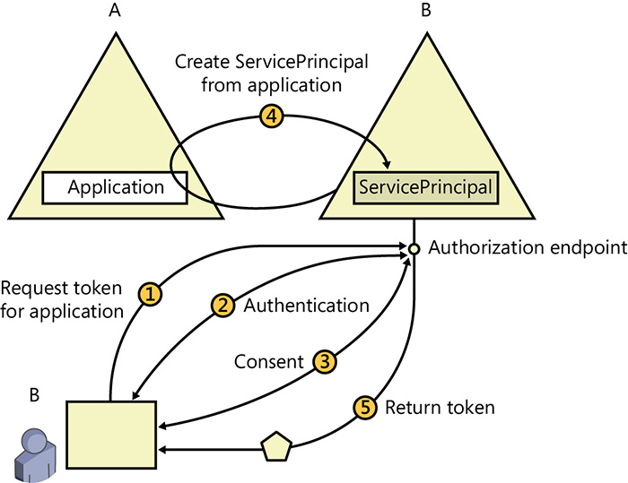
Simplified provisioning flow driven by consent
a user from B attempts to sign in with the app;
the user credentials are acquired and verified;
the user is prompted to consent for the app to gain access to tenant B; the user consents;
Azure AD uses the Application object in A as a blueprint for creating a ServicePrincipal in B;
the user receives the requested token.

Slide 9
Permissions types
Delegated permissions
Used by apps that have a signed-in user present in order to make calls as that user
App makes call on behalf of the user.
Can often be consented to by non-administrative users, but some higher-privileged permissions require admin consent
“Effective” permissions are the intersection of the User’s underlying permissions and what the application has been granted consent to do
As Known as : scopes, OAuth2PermissionGrants, App+User permissions, etc.
Application Permissions
Used by apps that run without a signed-in user present, like background services
App is using its own identity
Application has permission to do what it was consented to- no intersection
Usually require admin consent
As Known as : roles, AppRoles, AppOnly permissions, etc.

Slide 10
Effective Permissions
Application type
Scenario
Consent
Effective Permissions
Delegated Permissions
Aka : scopes, OAuth2PermissionGrants, App+User permissions, etc.
Application Permissions Aka : roles, AppRoles, AppOnly permissions, etc
Mobile / Web App / SPA (Single Page App)
Service (WebAPI) / Daemon
Get access on behalf of users
Get access as a service
Users for self / Admin for self or all users
Only admin can consent
Permissions granted to App
App
+
User
Permissions granted to App
User’s Permissions

Slide 11



Azure AD App Authentication Scenarios – Generic
(Walkthrough available here)
WS-Fed, SAML 2.0, OpenID Connect
Web application
OAuth 2.0
Web API
Browser
Native app
OAuth 2.0
OAuth 2.0
Web API
Web API
Server app
OAuth 2.0
OAuth 2.0

Slide 12
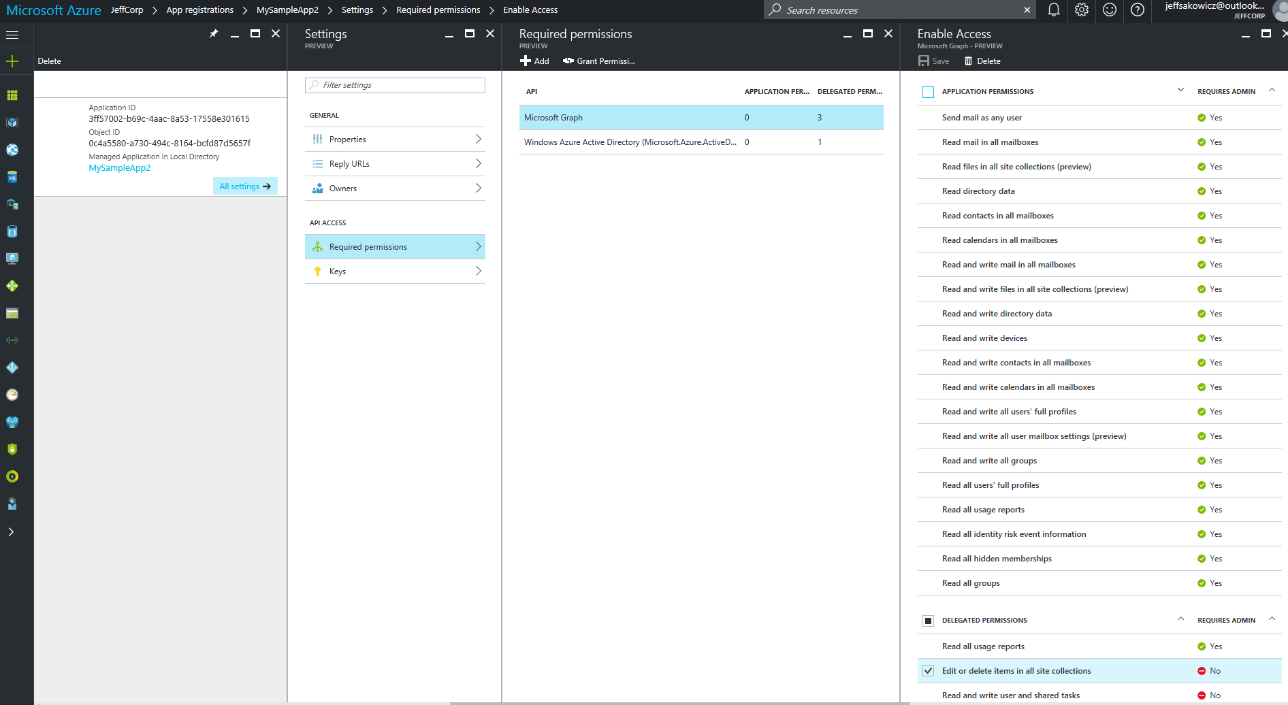
Existing Consent flow (1/6) : Developer Chooses Permissions Their App Will Request
Developer Chooses Permissions Their App Will Request
Application Permissions Aka : roles, AppRoles, AppOnly permissions, etc
Delegated Permissions
Aka : scopes, OAuth2PermissionGrants, App+User permissions, etc.

Slide 13
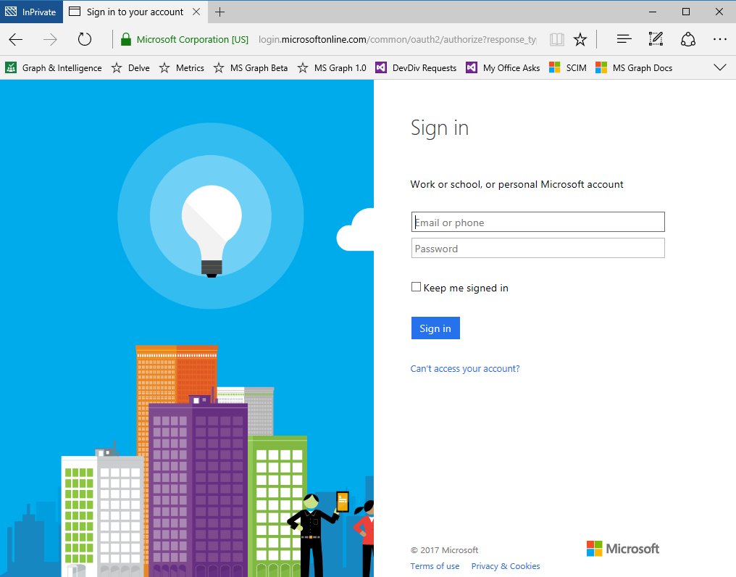
Existing Consent flow (2/6) : Upon first use of app: authentication
If the user is not already authenticated they will be asked to sign in

Slide 14
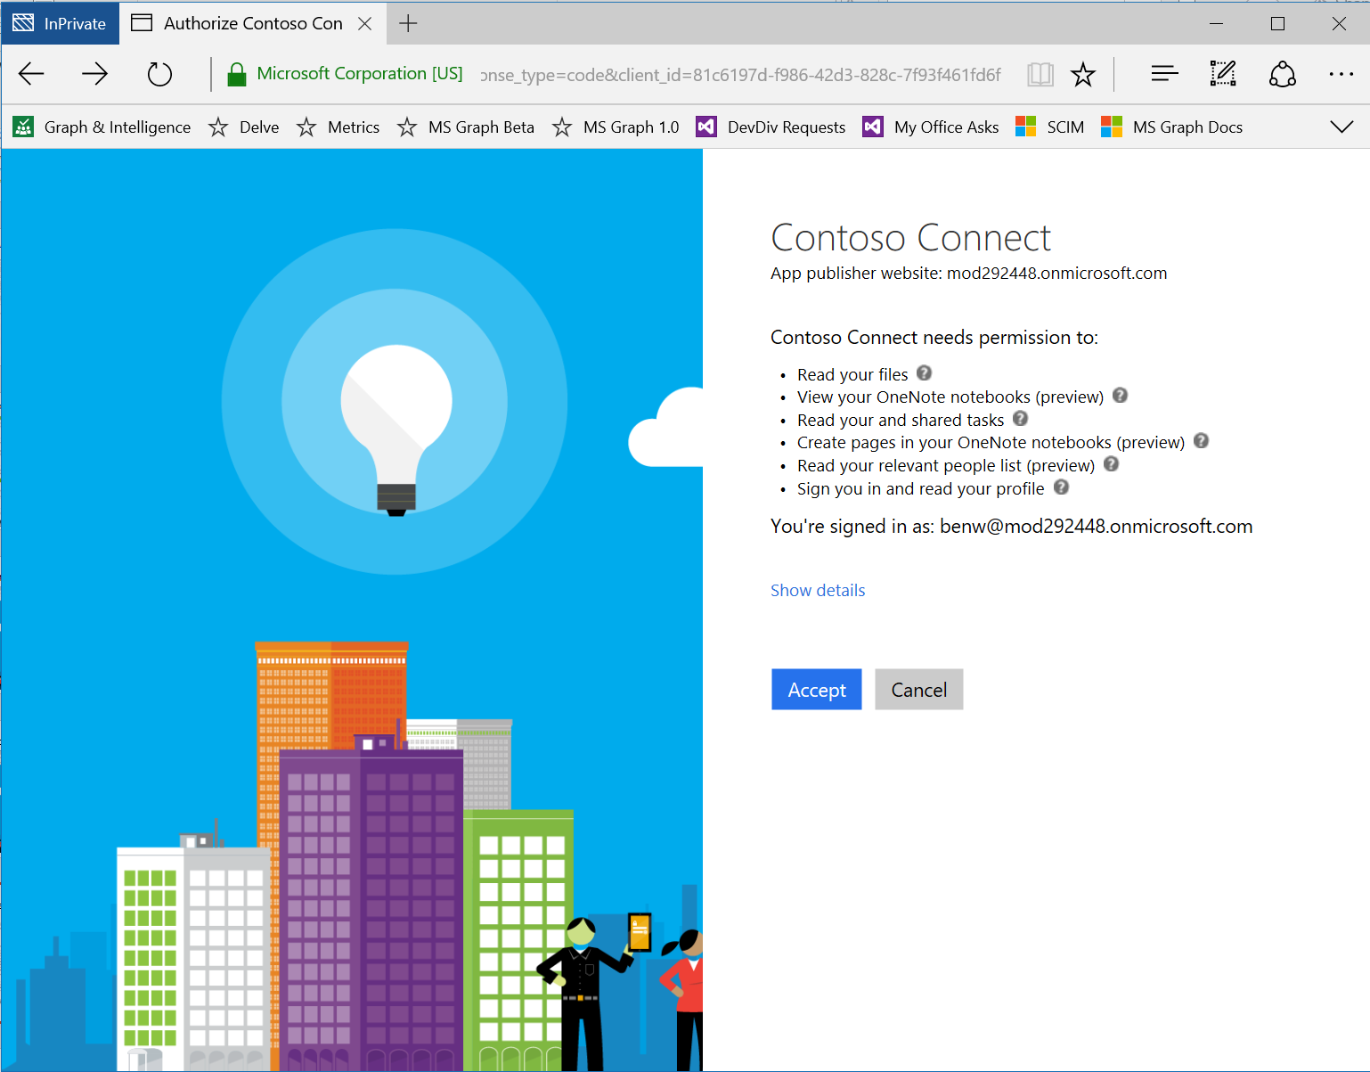
Existing Consent flow (3/6) : Upon first use of app: end-user consent
After authentication a consent prompt is shown, asking for the permissions requested by the application

Slide 15
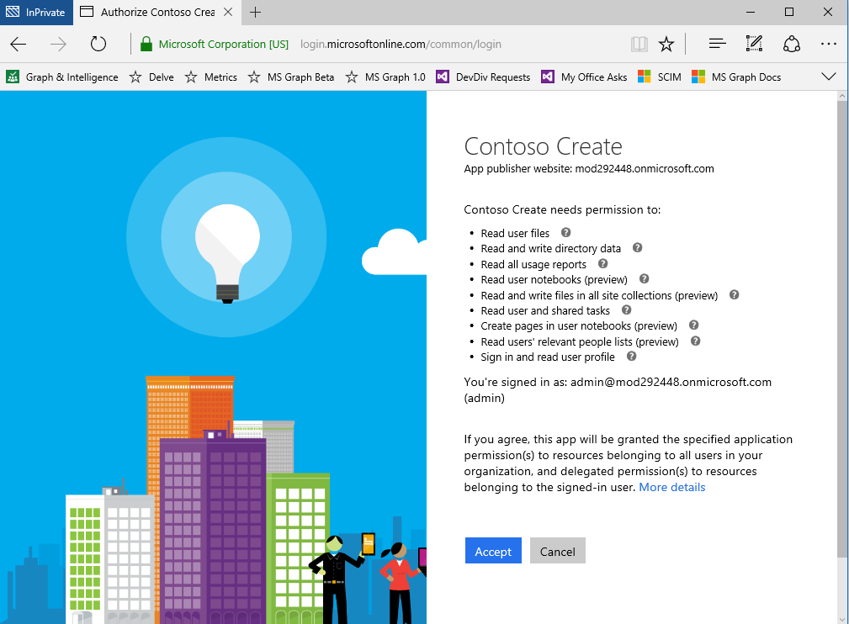
Existing Consent flow (4/6) : Upon first use of app: admin consent
If the user is an administrator, they will be asked to consent on behalf of their organization

Slide 16
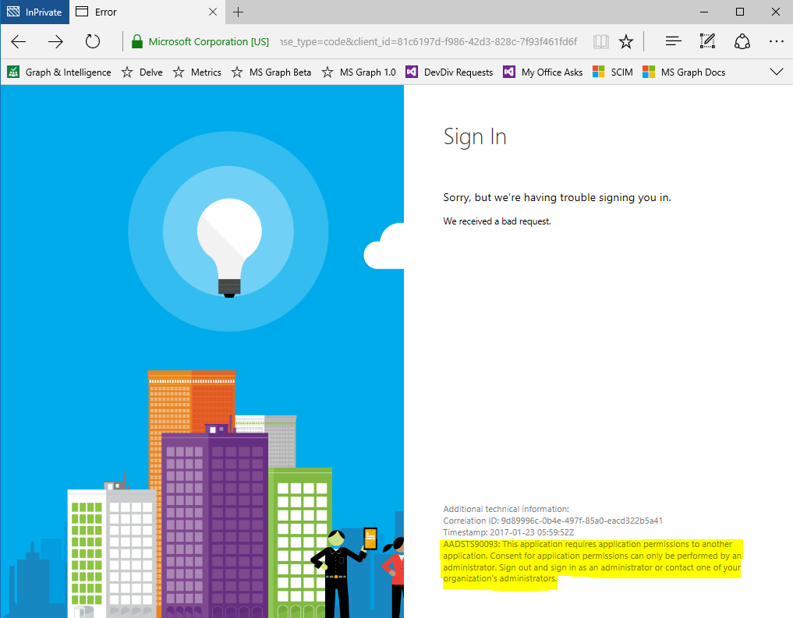
Existing Consent flow (5/6) : Admin intervention required
Non-admin users are not able to consent if admin-level permissions are requested
(in case of application permissions)

Slide 17
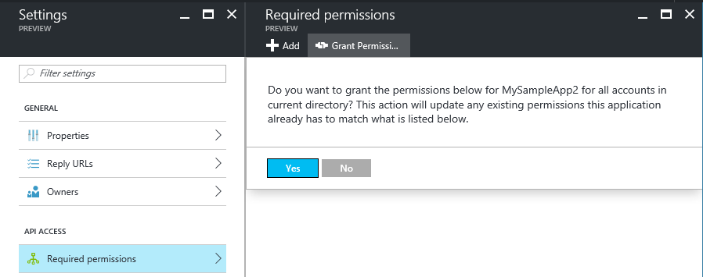
Existing Consent flow (6/6) : Administrators can also grant permissions via Azure Portal
Note: access to data can also be granted “manually” via management tools like PowerShell, the Graph API, etc.

Slide 18
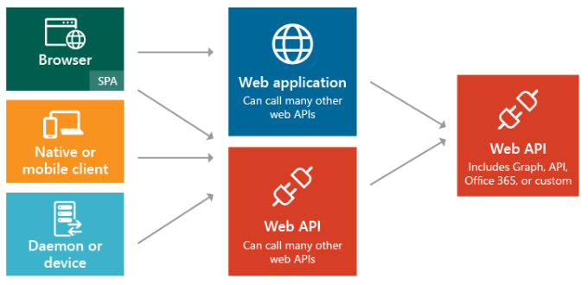
Types of application supported the Azure Active Directory
These are the five primary application scenarios supported by Azure AD:
Web Browser to Web Application: A user needs to sign in to a web application that is secured by Azure AD.
Single Page Application (SPA): A user needs to sign in to a single page application that is secured by Azure AD.
Native Application to Web API: A native application that runs on a phone, tablet, or PC needs to authenticate a user to get resources from a web API that is secured by Azure AD.
Web Application to Web API: A web application needs to get resources from a web API secured by Azure AD.
Daemon or Server Application to Web API: A daemon application or a server application with no web user interface needs to get resources from a web API secured by Azure AD.
1
2
4
3
5
5
These are the five primary application scenarios supported by Azure AD:
Notes:
https://docs.microsoft.com/azure/active-directory/develop/active-directory-authentication-scenarios#daemon-or-server-application-to-web-api

Slide 19
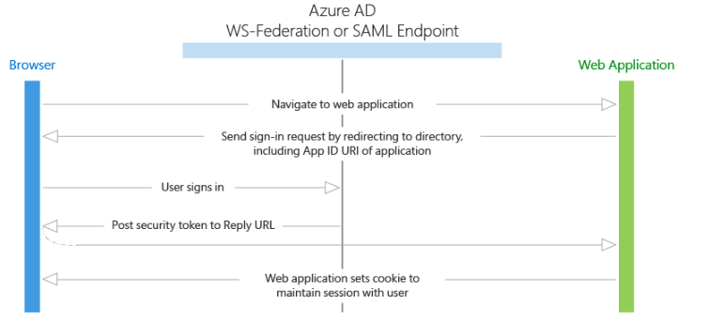
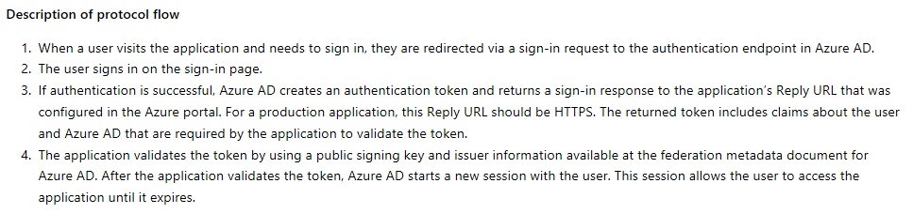
Web Browser to Web Application
In this scenario, the web application directs the user’s browser to sign them in to Azure AD.
Azure AD returns a sign-in response through the user’s browser, which contains claims about the user in a security token.
This scenario supports sign-on using the WS-Federation, SAML 2.0, and OpenID Connect protocols.
Notes:
https://docs.microsoft.com/en-us/azure/active-directory/develop/active-directory-authentication-scenarios#web-browser-to-web-application
Description of protocol flow
When a user visits the application and needs to sign in, they are redirected via a sign-in request to the authentication endpoint in Azure AD.
The user signs in on the sign-in page.
If authentication is successful, Azure AD creates an authentication token and returns a sign-in response to the application’s Reply URL that was configured in the Azure portal. For a production application, this Reply URL should be HTTPS. The returned token includes claims about the user and Azure AD that are required by the application to validate the token.
The application validates the token by using a public signing key and issuer information available at the federation metadata document for Azure AD. After the application validates the token, Azure AD starts a new session with the user. This session allows the user to access the application until it expires.

Slide 20
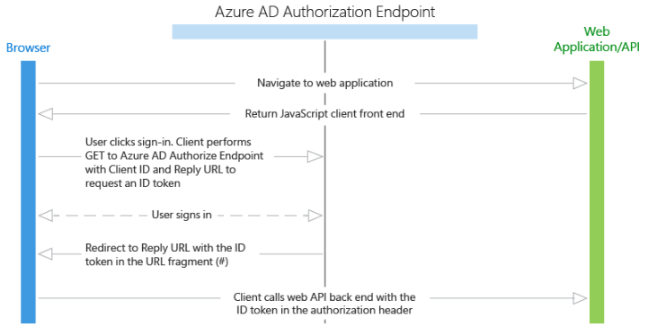
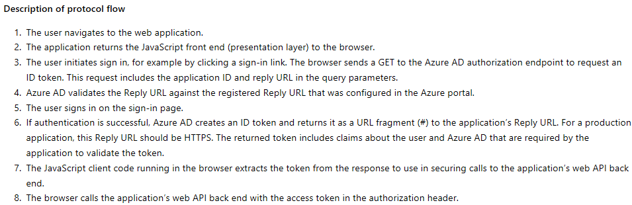
Single Page Application (SPA)
This scenario uses Azure AD and the OAuth 2.0 implicit authorization grant to secure its web API back end.
Single Page Applications are typically structured as a JavaScript presentation layer (front end) that runs in the browser and a Web API back end that runs on a server and implements the application’s business logic.
In this scenario, when the user signs in, the JavaScript front end uses Active Directory Authentication Library for JavaScript (ADAL.JS) and the implicit authorization grant to obtain an ID token (id_token) from Azure AD. The token is cached and the client attaches it to the request as the bearer token when making calls to its Web API back end.
Notes:
https://docs.microsoft.com/en-gb/azure/active-directory/develop/active-directory-authentication-scenarios#single-page-application-spa
Description of protocol flow
The user navigates to the web application.
The application returns the JavaScript front end (presentation layer) to the browser.
The user initiates sign in, for example by clicking a sign-in link. The browser sends a GET to the Azure AD authorization endpoint to request an ID token. This request includes the application ID and reply URL in the query parameters.
Azure AD validates the Reply URL against the registered Reply URL that was configured in the Azure portal.
The user signs in on the sign-in page.
If authentication is successful, Azure AD creates an ID token and returns it as a URL fragment (#) to the application’s Reply URL. For a production application, this Reply URL should be HTTPS. The returned token includes claims about the user and Azure AD that are required by the application to validate the token.
The JavaScript client code running in the browser extracts the token from the response to use in securing calls to the application’s web API back end.
The browser calls the application’s web API back end with the access token in the authorization header.

Slide 21
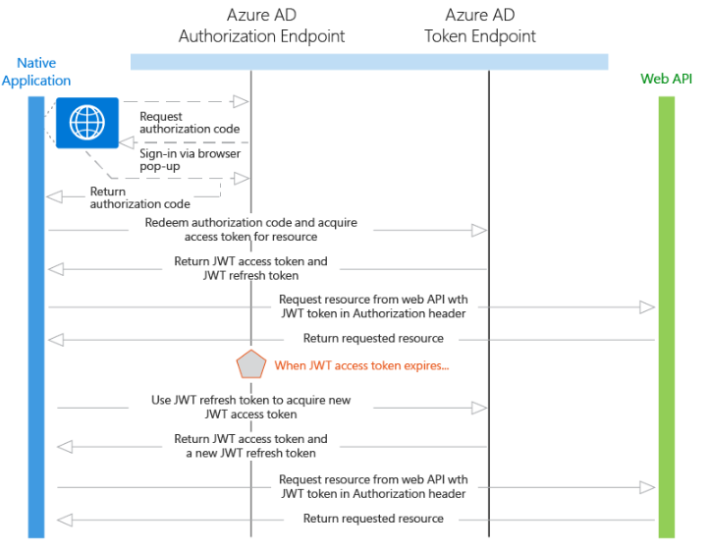
Native Application to Web API
Scenario where a native application calls a web API on behalf of a user.
This scenario is built on the OAuth 2.0 authorization code grant type with a public client,
See section 4.1 of the OAuth 2.0 specification).
The native application obtains an access token for the user by using the OAuth 2.0 protocol.
This access token is then sent in the request to the web API, which authorizes the user and returns the desired resource
The protocol description flow is given in the slide notes part.
Notes:
https://docs.microsoft.com/en-gb/azure/active-directory/develop/active-directory-authentication-scenarios#native-application-to-web-api
Description of protocol flow
If you are using the AD Authentication Libraries, most of the protocol details described below are handled for you, such as the browser pop-up, token caching, and handling of refresh tokens.
Using a browser pop-up, the native application makes a request to the authorization endpoint in Azure AD. This request includes the Application ID and the redirect URI of the native application as shown in the Azure portal, and the application ID URI for the web API. If the user hasn’t already signed in, they are prompted to sign in again
Azure AD authenticates the user. If it is a multi-tenant application and consent is required to use the application, the user will be required to consent if they haven’t already done so. After granting consent and upon successful authentication, Azure AD issues an authorization code response back to the client application’s redirect URI.
When Azure AD issues an authorization code response back to the redirect URI, the client application stops browser interaction and extracts the authorization code from the response. Using this authorization code, the client application sends a request to Azure AD’s token endpoint that includes the authorization code, details about the client application (Application ID and redirect URI), and the desired resource (application ID URI for the web API).
The authorization code and information about the client application and web API are validated by Azure AD. Upon successful validation, Azure AD returns two tokens: a JWT access token and a JWT refresh token. In addition, Azure AD returns basic information about the user, such as their display name and tenant ID.
Over HTTPS, the client application uses the returned JWT access token to add the JWT string with a “Bearer” designation in the Authorization header of the request to the web API. The web API then validates the JWT token, and if validation is successful, returns the desired resource.
When the access token expires, the client application will receive an error that indicates the user needs to authenticate again. If the application has a valid refresh token, it can be used to acquire a new access token without prompting the user to sign in again. If the refresh token expires, the application will need to interactively authenticate the user once again.
Note
The refresh token issued by Azure AD can be used to access multiple resources. For example, if you have a client application that has permission to call two web APIs, the refresh token can be used to get an access token to the other web API as well

Slide 22
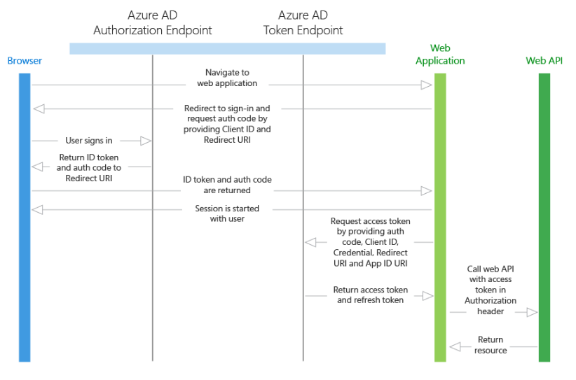
Web Application to Web API
Scenario where a web application needs to get resources from a web API.
In this scenario, there are two identity types that the web application can use to authenticate and call the web API:
an (client) application identity,
or a delegated user identity.
Application identity:
This scenario uses OAuth 2.0 client credentials grant to authenticate as the application and access the web API.
When using an application identity, the web API can only detect that the web application is calling it, as the web API does not receive any information about the user. If the application receives information about the user, it will be sent via the application protocol, and it is not signed by Azure AD. The web API trusts that the web application authenticated the user. For this reason, this pattern is called a trusted subsystem.
Delegated user identity:
This scenario can be accomplished in two ways:
OpenID Connect, and OAuth 2.0 authorization code grant with a confidential client.
The web application obtains an access token for the user, which proves to the web API that the user successfully authenticated to the web application and that the web application was able to obtain a delegated user identity to call the web API. This access token is sent in the request to the web API, which authorizes the user and returns the desired resource.
The protocol description flow is given in the slide notes part.
Notes:
https://docs.microsoft.com/en-gb/azure/active-directory/develop/active-directory-authentication-scenarios#web-application-to-web-api
Application identity with OAuth 2.0 client credentials grant
A user is signed in to Azure AD in the web application (see the Web Browser to Web Application above).
The web application needs to acquire an access token so that it can authenticate to the web API and retrieve the desired resource. It makes a request to Azure AD’s token endpoint, providing the credential, Application ID, and web API’s application ID URI.
Azure AD authenticates the application and returns a JWT access token that is used to call the web API.
Over HTTPS, the web application uses the returned JWT access token to add the JWT string with a “Bearer” designation in the Authorization header of the request to the web API. The web API then validates the JWT token, and if validation is successful, returns the desired resource.
Delegated user identity with OpenID Connect
A user is signed in to a web application using Azure AD (see the Web Browser to Web Application section above). If the user of the web application has not yet consented to allowing the web application to call the web API on its behalf, the user will need to consent. The application will display the permissions it requires, and if any of these are administrator-level permissions, a normal user in the directory will not be able to consent. This consent process only applies to multi-tenant applications, not single tenant applications, as the application will already have the necessary permissions. When the user signed in, the web application received an ID token with information about the user, as well as an authorization code.
Using the authorization code issued by Azure AD, the web application sends a request to Azure AD’s token endpoint that includes the authorization code, details about the client application (Application ID and redirect URI), and the desired resource (application ID URI for the web API).
The authorization code and information about the web application and web API are validated by Azure AD. Upon successful validation, Azure AD returns two tokens: a JWT access token and a JWT refresh token.
Over HTTPS, the web application uses the returned JWT access token to add the JWT string with a “Bearer” designation in the Authorization header of the request to the web API. The web API then validates the JWT token, and if validation is successful, returns the desired resource.
Delegated user identity with OAuth 2.0 authorization code grant
A user is already signed in to a web application, whose authentication mechanism is independent of Azure AD.
The web application requires an authorization code to acquire an access token, so it issues a request through the browser to Azure AD’s authorization endpoint, providing the Application ID and redirect URI for the web application after successful authentication. The user signs in to Azure AD.
If the user of the web application has not yet consented to allowing the web application to call the web API on its behalf, the user will need to consent. The application will display the permissions it requires, and if any of these are administrator-level permissions, a normal user in the directory will not be able to consent. This consent applies to both single and multi-tenant application. In the single tenant case, an admin can perform admin consent to consent on behalf of their users. This can be done using the Grant Permissions button in the Azure Portal.
After the user has consented, the web application receives the authorization code that it needs to acquire an access token.
Using the authorization code issued by Azure AD, the web application sends a request to Azure AD’s token endpoint that includes the authorization code, details about the client application (Application ID and redirect URI), and the desired resource (application ID URI for the web API).
The authorization code and information about the web application and web API are validated by Azure AD. Upon successful validation, Azure AD returns two tokens: a JWT access token and a JWT refresh token.
Over HTTPS, the web application uses the returned JWT access token to add the JWT string with a “Bearer” designation in the Authorization header of the request to the web API. The web API then validates the JWT token, and if validation is successful, returns the desired resource.

Slide 23
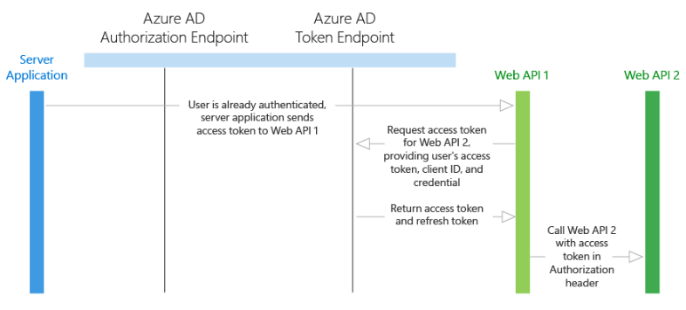
Daemon or Server Application to Web API
A daemon or server application needs to get resources from a web API. There are two sub-scenarios that apply to this section:
A daemon that needs to call a web API, built on OAuth 2.0 client credentials grant type
and a server application (such as a web API) that needs to call a web API, built on OAuth 2.0 On-Behalf-Of draft specification.
The protocol description flow is given in the slide notes part.
Notes:
https://docs.microsoft.com/en-gb/azure/active-directory/develop/active-directory-authentication-scenarios#daemon-or-server-application-to-web-api
Description of protocol flow
Application identity with OAuth 2.0 client credentials grant
First, the server application needs to authenticate with Azure AD as itself, without any human interaction such as an interactive sign-on dialog. It makes a request to Azure AD’s token endpoint, providing the credential, Application ID, and application ID URI.
Azure AD authenticates the application and returns a JWT access token that is used to call the web API.
Over HTTPS, the web application uses the returned JWT access token to add the JWT string with a “Bearer” designation in the Authorization header of the request to the web API. The web API then validates the JWT token, and if validation is successful, returns the desired resource.
Delegated user identity with OAuth 2.0 On-Behalf-Of Draft Specification
The flow discussed below assumes that a user has been authenticated on another application (such as a native application), and their user identity has been used to acquire an access token to the first-tier web API.
The native application sends the access token to the first-tier web API.
The first-tier web API sends a request to Azure AD’s token endpoint, providing its Application ID and credentials, as well as the user’s access token. In addition, the request is sent with an on_behalf_of parameter that indicates the web API is requesting new tokens to call a downstream web API on behalf of the original user.
Azure AD verifies that the first-tier web API has permissions to access the second-tier web API and validates the request, returning a JWT access token and a JWT refresh token to the first-tier web API.
Over HTTPS, the first-tier web API then calls the second-tier web API by appending the token string in the Authorization header in the request. The first-tier web API can continue to call the second-tier web API as long as the access token and refresh tokens are valid.

Slide 24
Application model Azure AD objects
3 kind of objects
Application Object | Applications are usually an abstract entity, made of code and resources: the service principal represents a concrete instance of that abstract entity in a specific directory.
Service Principal Object | In traditional Active Directory, every entity that can be authenticated is represented by a principal. That’s true for users, and that’s true for applications—in the latter case, we speak of service principals. At deployment time a given Application object can be used as a blueprint to create a ServicePrincipal representing a concrete instance of an application in a directory. It’s that ServicePrincipal that is used to define what the app can actually do in that specific target directory, who can use it, what resources it has access to, and so on
OAuth2PermissionGrants Object | Azure AD maintains another collection of entities, named oauth2PermissionGrants, which records which clients (the applications) have access to which resources (other SaaS services e.g. AAD) and with what permissions (e.g. read user data). Critically, oauth2PermissionGrants also records which users that consent is valid for. The oauth2PermissionGrants object represents the OAuth 2.0 delegated permission scopes that have been granted to an application (represented by a service principal) as part of the user or admin consent process.
Notes:
This article gives a good overview of the Application and Service principal objects that are core to our app model: https://docs.microsoft.com/en-us/azure/active-directory/develop/active-directory-application-objects
Where can I find all the properties on the application/servicePrincipal objects ?
through the public documentation: https://msdn.microsoft.com/en-us/Library/Azure/Ad/Graph/api/entity-and-complex-type-reference
What is the difference between service principal and an application?
Application entity contains the configuration of the software / service that can be used to call cloud apis. Service principal represents the acquisition of the application in a customer tenant (the consent) along with the granted permissions.

Slide 25
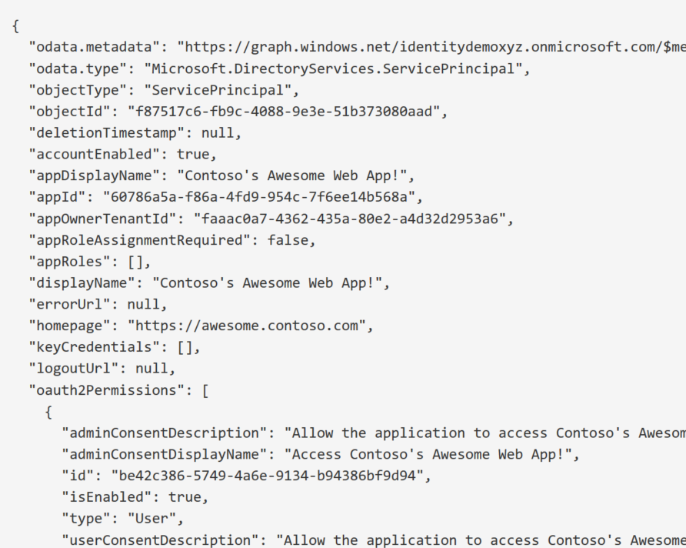
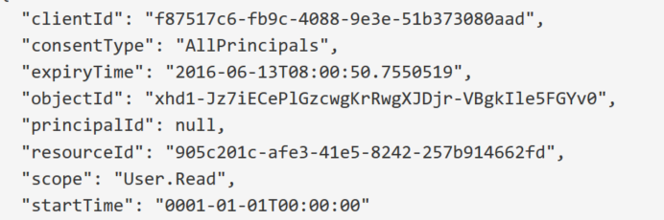
Service principals
Registered applications get a ServicePrincipal object in the tenant’s directory
OAuth2PermissionGrants are assigned to ServicePrincipal to dictate what they can access

Slide 26
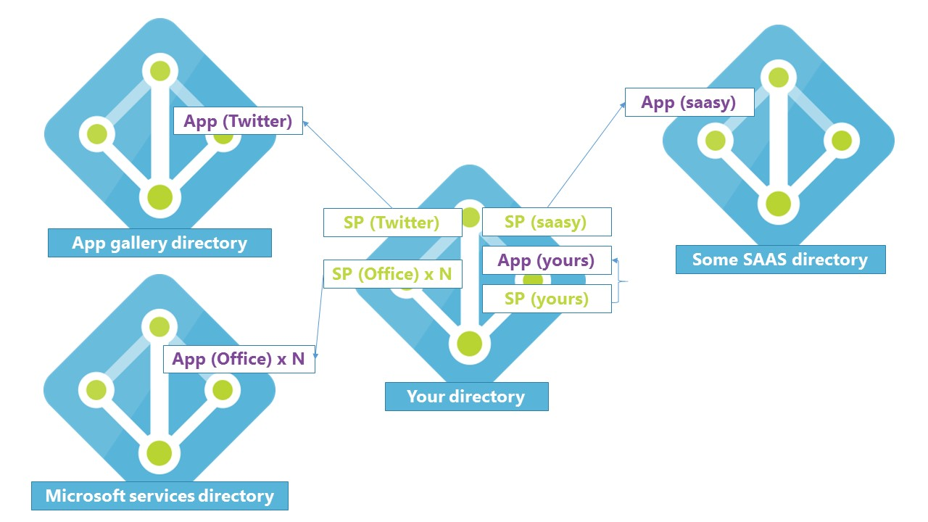
Microsoft apps / Gallery apps /Saas apps directories
Microsoft maintains two directories internally (on the left) it uses to publish applications.
One for Microsoft Apps (Microsoft services directory)
One for pre-integrated 3rd Party Apps (App Gallery directory)
Application publishers/vendors who integrate with Azure AD are required to have a publishing directory. (Some SAAS Directory).
Applications that you add yourself include:
Apps you developed (integrated with AAD)
Apps you connected for single-sign-on
Apps you published using the Azure AD application proxy.
Notes:
Recall SP means “Service Principal” objects
Gallery Application
Developed and published by 3rd party and NOT registered for multi-tenant
Any AAD tenant can added it and use it
Both, application object and service principal is generated
For the tenant, it´s like a new application
Definition :
Azure AD App Gallery is primarily intended for multi-tenant SaaS apps where a customer can sign up for the apps and get their own tenant in the cloud.​
The purpose of the App Gallery is to show directory admins and prospective customers what apps support integration with Azure AD, and also for app developers to advertise their integrations.​
Azure AD App Gallery is global, meaning every listed app is visible to every customer. Azure AD will not publish apps to the Gallery that can only be used by one customer.

Slide 27
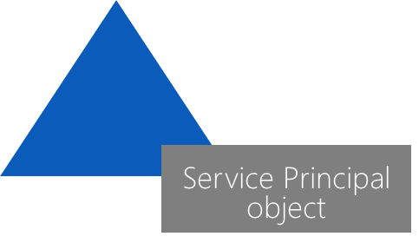
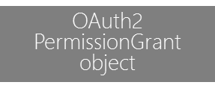
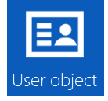

AAD Objects Relationships
AAD
AAD Tenant providing the application service A
X
Other AAD Tenants consuming the application service A
Multi-tenant app A
Application object A
User consent objects exist per application, permission and user
AAD
Y
User Consent
ServicePrincipal object A
OAuth2 PermissionGrant object
User object
Single-tenant app B
consentType: “Principal”
By default a Service Principal object (pointing to the Application object) will be automatically created when the first user (from tenant Y) who tries to access the application is asked to provide consent
Application object B
ServicePrincipal object B
Admin consent objects exist per application and permission. If an admin consent exists – no more user consent dialogues pop up.
OAuth2 PermissionGrant object
AAD consuming the application services
Admin Consent
consentType: “AllPrincipals”
AAD Y Tenant

Slide 28

Consent and authorization best practices
Adopt consent and authorization best practices
The most widely adopted apps in Azure AD generally follow these already
http://aka.ms/GraphBestPractices
Use least privilege.
Use the correct permission type based on scenarios.
Consider multi-tenant applications
Show that you have been thoughtful with your permission requests:
Only ask for what is absolutely necessary
Use the correct permission type based on scenarios
Use incremental consent to request granular permissions just in time
Provide Terms of Service and Privacy Statement

Slide 29
Defending Against Illicit Consent Grant
An interesting blog about an emergent threat (Illicit Consent Grants) with detailed explanation (how to detect, monitor, and remediate) , with detection scripts of applications having access.
Defending Against Illicit Consent Grants: https://blogs.technet.microsoft.com/office365security/defending-against-illicit-consent-grants/
Notes:
Reference Documentation
This article walks admins through various actions they may want to take after realizing there are unexpected applications with access to data: https://docs.microsoft.com/en-us/azure/active-directory/application-access-unexpected-application
Here is a high level overview doc on consent and permissions: https://docs.microsoft.com/en-us/azure/active-directory/active-directory-apps-permissions-consent
There is another overview here, which is part of an article on our app model all up which includes various code samples and walkthroughs: https://docs.microsoft.com/en-us/azure/active-directory/develop/active-directory-integrating-applications#overview-of-the-consent-framework
Here is a content map that links to various consent-related articles: https://docs.microsoft.com/en-us/azure/active-directory/active-directory-application-dev-development-content-map
This article gives a good overview of the Application and Service principal objects that are core to our app model: https://docs.microsoft.com/en-us/azure/active-directory/develop/active-directory-application-objects
Here is an overview of the capabilities admins have to manage user access to apps: https://docs.microsoft.com/en-us/azure/active-directory/active-directory-managing-access-to-apps

